Slide 1
Redlining and the Community Reinvestment Act in Los Angeles
By Peter Mannino

Slide 2
Table of Contents
Introduction
Redlining In Historical View
Present Day Descriptions
Redlining and Homeownership
The Community Reinvestment Act (CRA)

Slide 3
Redlining Was Government Sanctioned Lending Discrimination
In the 1930’s the Home Owners Loan Corporation (HOLC) surveyed metropolitan regions around the country and graded the credit worthiness of neighborhoods within each region (Richmond 2019).
The neighborhoods that were largely African American were given the lowest score - the neighborhoods were colored red on maps (Richmond 2019).
These scores were used as justification by the HOLC and later the Federal Housing Administration for refusing to lend to predominantly African American neighborhoods (Richmond 2019).
Limited their ability to build wealth and kept them trapped in these poor neighborhoods.
Introduction
Historical View
Descriptions
Homeownership
CRA

Slide 4
Policy Context and Research Question
Context
Today, there is extreme inequality in homeownership across communities in LA with neighborhoods like Koreatown containing only 6% homeowners while in Bel Air over 82% of household own their home (Census Bureau 2019).
Question
How did the historical redlining of neighborhoods in LA contribute to the differences in home ownership today?
Has the Community Reinvestment Act helped address historical disparities by incentivizing banks to lend in low income neighborhoods?
Introduction
Historical View
Descriptions
Homeownership
CRA

Slide 5
Data and Sources
Decennial Census from NHGIS
Five Year American Communities Survey 2014-2018
Mapping Inequality Project at University of Richmond
County of LA GIS Dataset
Community Reinvestment Act Data from PolicyMap Database
Introduction
Historical View
Descriptions
Homeownership
CRA

Slide 6
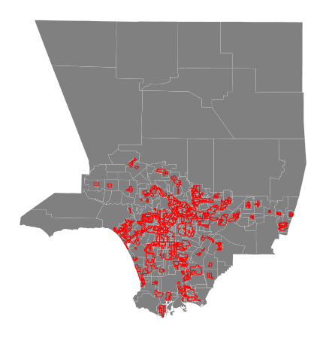
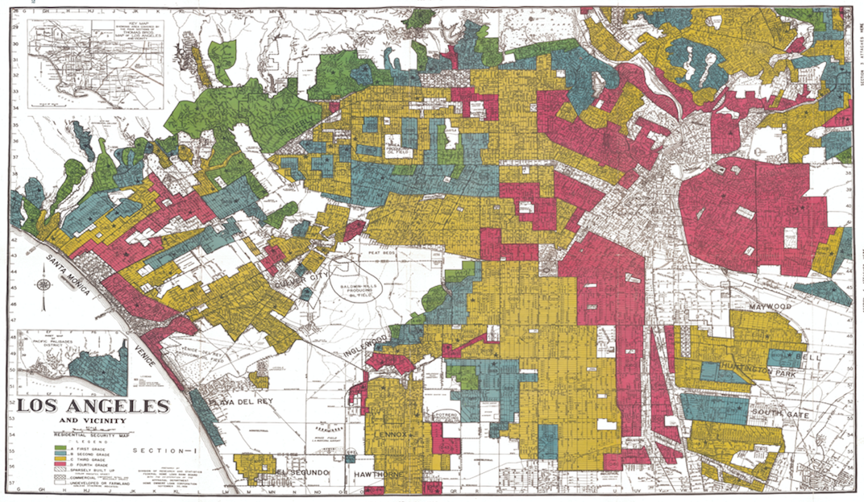
Redlined locations were concentrated in the core of Los Angeles
Historical Redlining Map
Digitized Redlined Areas*
*C and D graded areas are defined as “redlined”
Introduction
Historical View
Descriptions
Homeownership
CRA

Slide 7
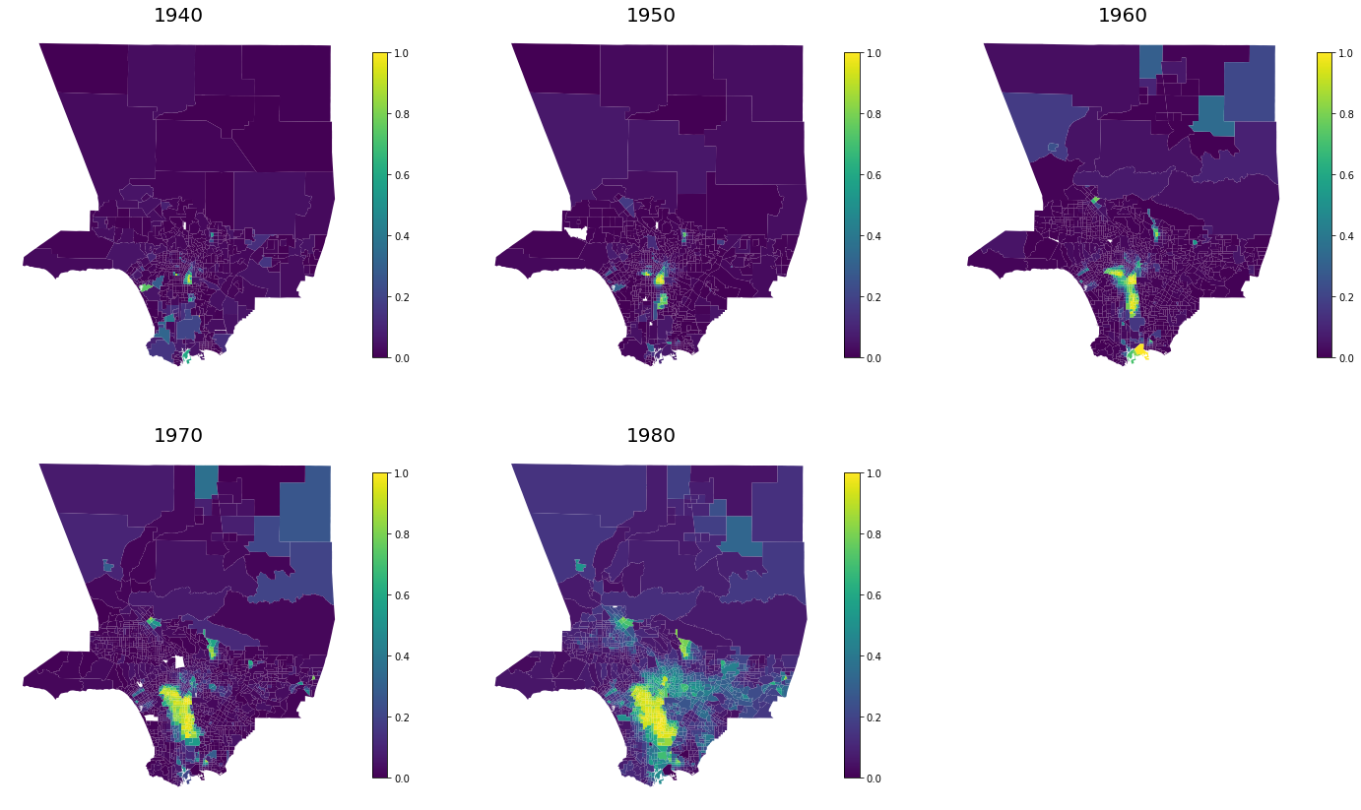
Non-white populations were forced to cluster in the redlined zones
Non-white Population Share 1940-1980
Introduction
Historical View
Descriptions
Homeownership
CRA

Slide 8
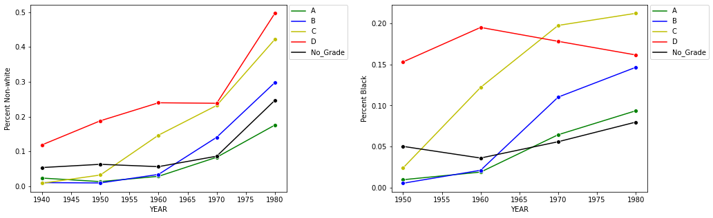
All areas have become more non-white over the 20th century
D graded areas were more non-white and black at the beginning of the period, but C graded areas quickly caught up
A graded areas are still substantially whiter than other areas
Non-white Share by Redlining Grade
Black Share by Redlining Grade
Introduction
Historical View
Descriptions
Homeownership
CRA

Slide 9
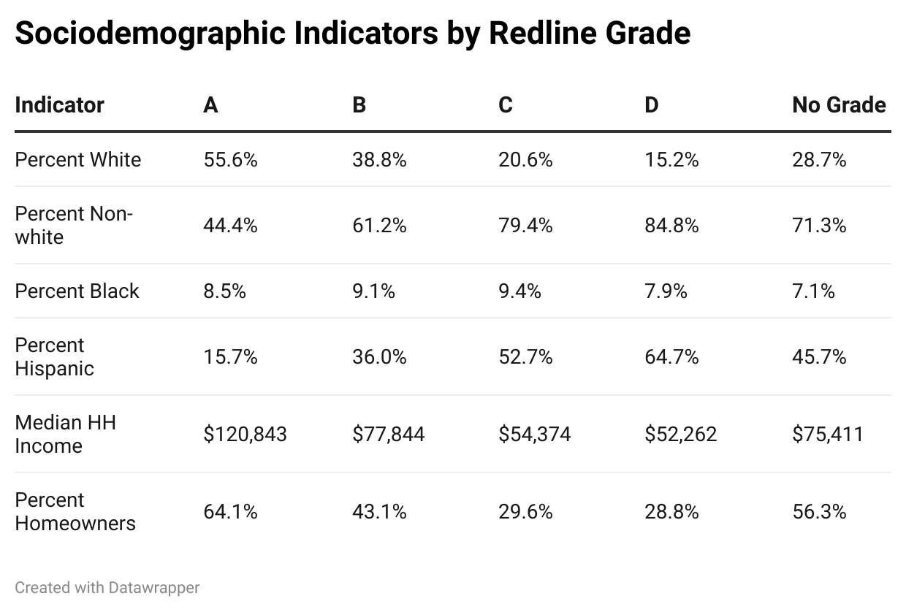
Across all indicators, C and D graded areas are more disadvantaged today
Introduction
Historical View
Descriptions
Homeownership
CRA

Slide 10
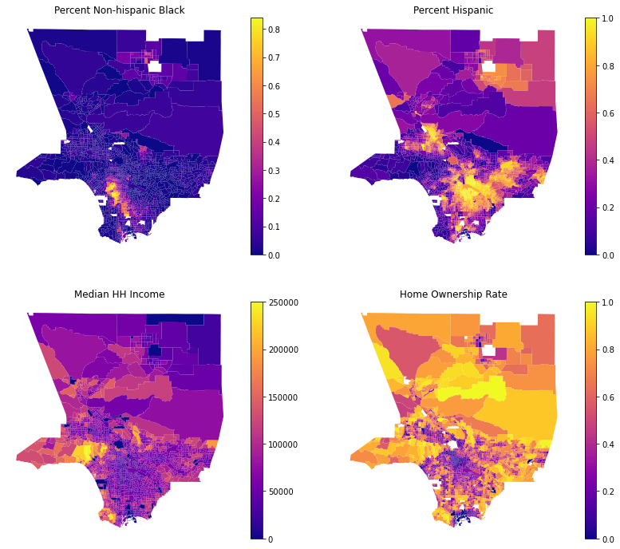
Disadvantage continues to cluster in the core of Los Angeles
Introduction
Historical View
Descriptions
Homeownership
CRA

Slide 11

Redlining and Homeownership OLS Regression
To determine if there is still a relationship between redlining and homeownership after controlling for race/ethnicity and income, I run the following regression:
$Homeownership Rate=β_{o}+β_{1}\left({Median HH Income}_{i}\right)+β_{2}\left({Percent Black}_{i}\right)+β_{3}\left({Percent Hispanic}_{i}\right)+β_{4}\left({Percent Other}_{i}\right)+ ε$
Introduction
Historical View
Descriptions
Homeownership
CRA

Slide 12
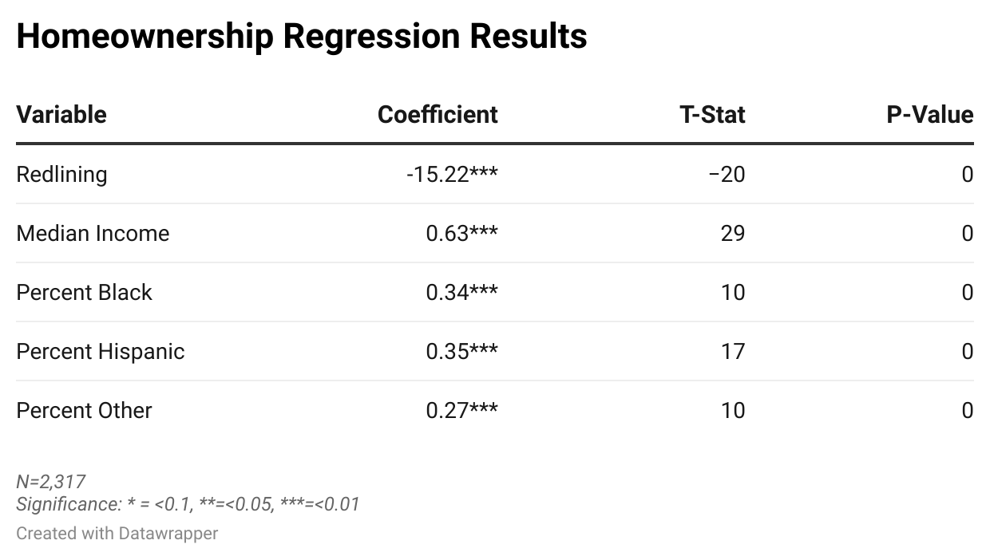
After controlling for income and race/ethnicity, redlining is associate with lower homeownership
Controlling for income and race/ethnicity, Redlining is associated with 15 percentage points lower homeownership rates
Introduction
Historical View
Descriptions
Homeownership
CRA

Slide 13
The Community Reinvestment Act was intended to address racial lending and homeownership disparities
The 1968 Civil Rights Act officially outlawed discrimination in housing and lending and ended government sanctioned mortgage discrimination
In 1977, Congress passed the Community Reinvestment Act, which requires federal regulators to encourage banks to make loans in low and moderate income neighborhoods.
Introduction
Historical View
Descriptions
Homeownership
CRA

Slide 14

Use a Regression Discontinuity design to assess whether the CRA increases lending
The program is designed so that any tract that has Median Family Income below 120% of the Area Median Family Income is CRA eligible. Banks can meet their CRA requirements by lending in these areas.
Therefore, if the CRA is working, we would expect to see an increase in lending to tracts just below the 120% threshold compared to those just above it
Regression Model:
$Mortgages Originated= β_{0}+β_{1}\left(D_{i}\right)+ β_{2}\left(X_{i}−X_{0}\right) +β_{3}(\left(X_{i}−X_{0}\right)∗D_{i})+ ε$
β1 is the variable of interest. We want it to be positive.
Introduction
Historical View
Descriptions
Homeownership
CRA

Slide 15
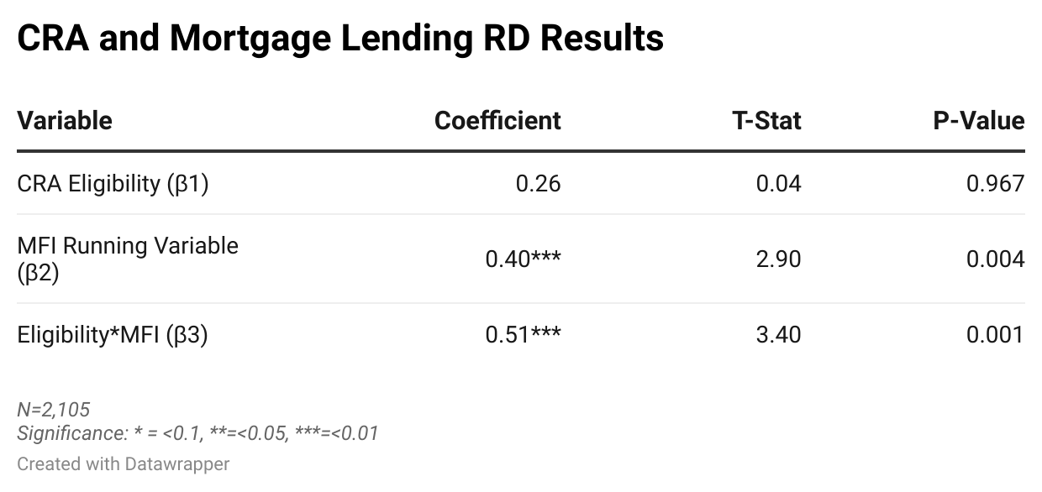
The CRA does not increase lending in eligible tracts in Los Angeles
β1 is the variable of interest and it is small and very statistically insignificant.
Introduction
Historical View
Descriptions
Homeownership
CRA

Slide 16
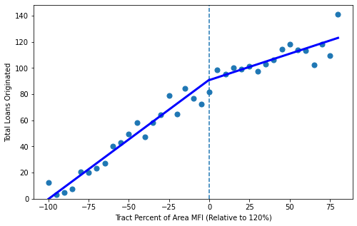
The CRA does not increase lending in eligible tracts in Los Angeles
Regression Discontinuity Results
If the CRA had a positive impact on lending, we would have expected to see a sudden break downward at the vertical line.
Instead we see a smooth transition across the threshold, indicating that the CRA had no effect.
Introduction
Historical View
Descriptions
Homeownership
CRA

Slide 17
Conclusions
Places that were redlined had more minority residents than places that were not.
Those areas became more heavily minority over time, but the higher graded areas also became more minority, just more slowly.
The C and D graded areas still have lower incomes and a higher share of minority residents today.
They are also associated with lower homeownership rates.
The Community Reinvestment Act is supposed to increase lending to low-income neighborhoods, but there is no evidence that it works in Los Angeles.
Introduction
Historical View
Descriptions
Homeownership
CRA

